Slide 1
CSE7302 - INTERNSHIP Review-5 Final Viva Presentation IoT-DRIVEN PREDICTIVE MAINTENANCE ANALYTICS FOR SECURITY AUTOMATION SYSTEMS
Student Details
Name | BHAGYAVARDHAN
Roll No | 20231CSE3038
Section | 8CSE09
Under the Supervision of,
Mr. Bikram Sarkar & Ms. Chinmayi G V Assistant Professor
School of Computer Science and Engineering Presidency University.
Name of the Program: Internship-CSE7302
Name of the HoD: Dr. Asif Mohammed
Name of the Program Internship Coordinator: Dr. Balakrishnan
Name of the School Internship Coordinator: Dr. Md Ziaur Rahman

Slide 2
Content
About Company or Organization
Working domain or the technology
About your team and reporting Manager
Challenges Faced in Internship
Objectives of the work
Literature Review
Proposed System
Problem Statement
System Requirements
Advantages of Proposed System/Work
System Design
System Implementation
System Testing
Conclusion
References
Github Link

Slide 3
About Company or Organization
Ankit Automations is a trusted name in the field of security and automation solutions.
With a focus on innovation, quality, and customer satisfaction, we provide a wide range of products designed to make spaces smarter, safer, and more efficient.
Join the growing number of clients who trust us to automate their world.

Slide 4
Product Offerings
Our offerings include boom barriers, sliding gates, automatic doors, garage door, gate motors, flap barriers, swing barriers, turnstiles, CCTV cameras, walkie-talkies, metal detectors, and handheld detectors & etc.
Whether it’s residential, commercial, or industrial, our automation solutions are tailored to meet the unique needs of each client.

Slide 5
Working domain or the technology
As a Data Analyst at Ankit Automations, you’ll collect and process data from security systems like CCTV cameras and access control devices to identify patterns in usage and potential vulnerabilities.
IoT sensors are used to continuously monitor operational parameters like temperature, voltage, uptime, and error frequency.
Security automation systems such as CCTV cameras, boom barriers, turnstiles, and access control systems form the core application area.

Slide 6
Continue…
Anomaly detection algorithms identify unusual events in turnstile and flap barrier data.
Integration of CCTV metadata with access control logs enables advanced analytics.
Time-series analysis handles usage logs and vibration patterns from automation devices.
Real-time alert systems reduce downtime and enhance overall security posture.

Slide 7
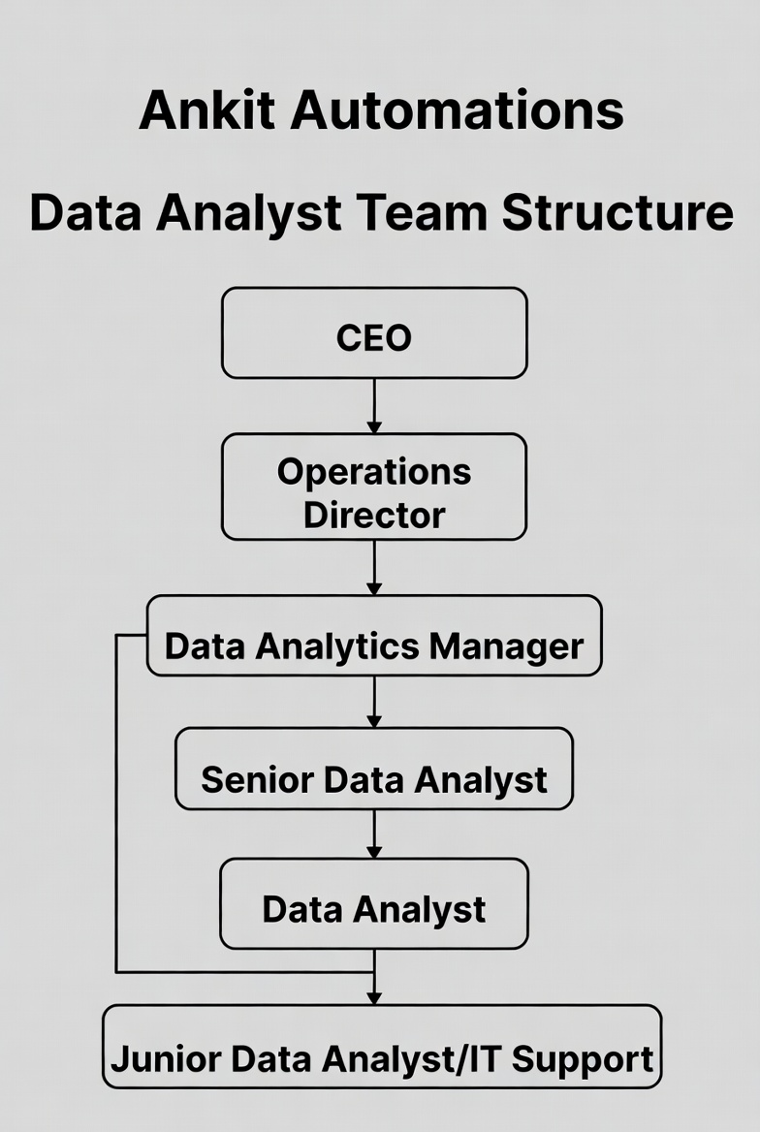
About your team and reporting Manager

Slide 8
Continue…
The internship was conducted at Ankit Automations, a company specializing in security and automation solutions.
The team includes automation engineers responsible for hardware deployment.
The reporting structure helps interns understand real-world organizational workflows.
The team follows professional communication and reporting standards.

Slide 9
Challenges Faced in Internship
Handling ambiguous stakeholder requirements without clear initial KPIs.
Limited access to real IoT sensor data forced creation of realistic synthetic datasets.
Managing hybrid work expectations and daily stand-up responsiveness.
Overcoming initial overfitting issues in early Random Forest models.

Slide 10
Objectives of the work
Developing an accurate predictive model to forecast maintenance needs for automation devices.
Support data-driven decision-making for inventory and demand forecasting.
Enhance innovation by identifying performance trends across product lines.
Build reusable pipeline for future expansion to CCTV and handheld detectors.

Slide 11
Literature Review
Research studies highlight predictive maintenance as superior to reactive methods.
Studies on security IoT data stress privacy-preserving federated learning techniques.
Existing systems lack integration between IoT and analytics.
Predictive maintenance literature emphasizes edge computing for real-time alerts.

Slide 12
Proposed System
Real-time IoT data ingestion from gate motors, boom barriers, and turnstiles.
The proposed system integrates IoT sensors with security devices.
Data is transmitted securely to cloud servers.
Maintenance schedules are optimized using analytics.
The solution improves system reliability and uptime.

Slide 13
Problem Statement
Existing maintenance methods are reactive.
Manual monitoring is inefficient and error-prone.
Maintenance costs increase due to emergency repairs.
Security automation systems face unexpected operational failures.
Maintenance schedules are not data-driven.

Slide 14
System Requirements
Laptops/Workstations: Development team using Windows 10/11 laptops with 16GB RAM, Intel i7 processors, and dual monitors for productivity.
Development Tools: Visual Studio Code for coding, GitHub for version control and collaboration, Docker for containerization ensuring consistent environments, and Postman for API testing.
ETL Tools: Apache Airflow for workflow orchestration and scheduling, custom Python scripts using SQL Alchemy for database connectivity, and Pandas for data transformation logic.

Slide 15
Continue….
Communication Tools: Slack for team collaboration, Microsoft Teams for meetings, and JIRA for project task tracking and sprint planning.
Monitoring Tools: AWS CloudWatch for infrastructure monitoring, Grafana for custom metrics dashboards, and PagerDuty for incident alerting and escalation management.
Backup Systems: AWS S3 with versioning enabled, automated backup scripts, and tested disaster recovery procedures with quarterly restoration drills.

Slide 16
Advantages of Proposed System
Lowers maintenance costs by shifting from reactive to proactive scheduling.
Reduces manual intervention.
Supports sustainability by optimizing energy usage in automated devices.
Extends equipment lifespan.

Slide 17
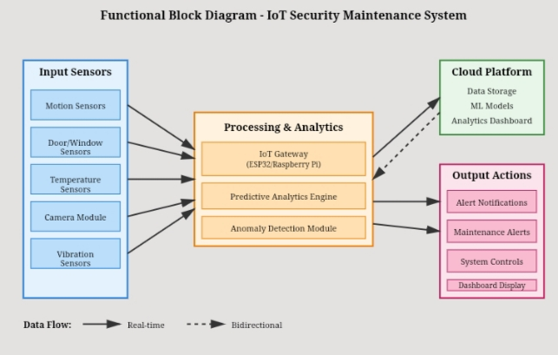
System Design
Figure 1.1 : System Design Block Diagram

Slide 18
Continue….
The System design specification establishes a contractual foundation defining what the system must accomplish, how it must perform, and under what constraints it must operate. Requirements are categorized into functional requirements (system capabilities and behaviours) and non-functional requirements (performance, reliability, security, usability attributes).
Database schema includes timestamp, device ID, vibration, temperature, and usage.
Modular design allows independent testing of each algorithm component.

Slide 19
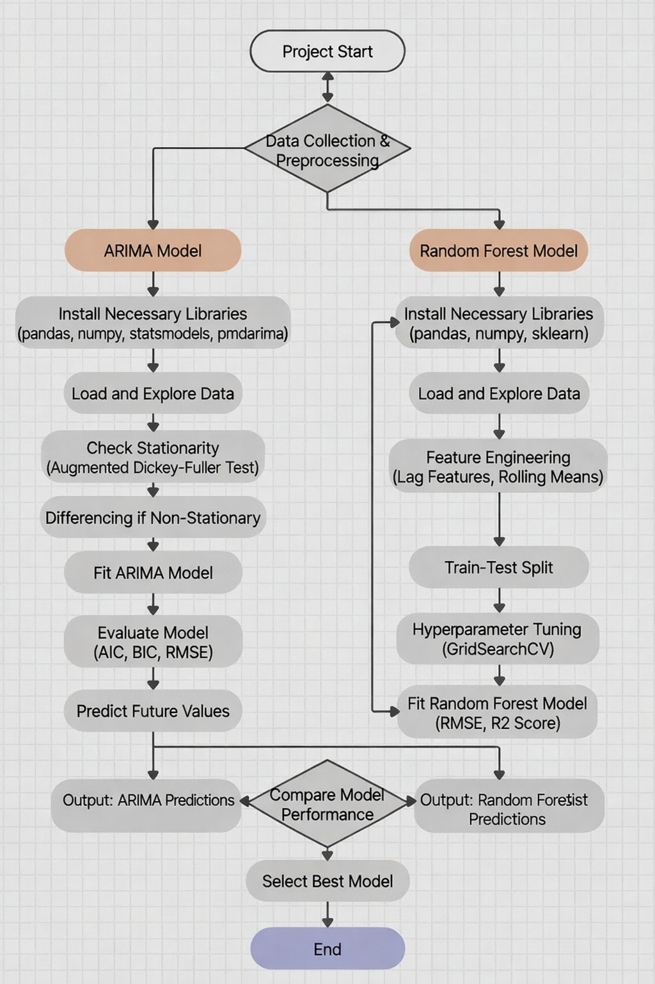
System Implementation
Figure 1.2 : System Implementation

Slide 20
Continue….
Prioritized maintenance work orders with resource assignments and scheduling recommendations.
Historical analytics enabling trend analysis and strategic planning.
Configuration parameters defining device types, criticality classifications, alert thresholds, maintenance rules, and user preferences.

Slide 21
System Testing
Bias and overfitting checks performed on residential vs industrial data.
Error handling testing confirms graceful recovery from missing values.
Security testing ensures anonymized data handling compliance.
Real-time simulation using synthetic IoT logs for alert validation.

Slide 22
Conclusion
Gained valuable real-world experience in IoT security analytics domain.
Demonstrated end-to-end algorithm implementation from data to dashboard.
Achieved key objectives of reducing downtime and enhancing client safety.
Implemented hybrid predictive maintenance system.

Slide 23
References
United Nations. (2015). Sustainable Development Goals. Available at: https://sdgs.un.org/goals [Accessed 17 January 2025].
National Health Profile. (2023). Emergency Medical Services Response Times in Urban India. Ministry of Health and Family Welfare, Government of India.
Smith, J.A. and Johnson, R.K. (2022). 'Accuracy of Manual Triage in High-Stress Emergency Situations', Journal of Emergency Medicine, 45(3), pp. 234-248.

Slide 24
Continue….
Brown, M.L. et al. (2023). 'Traditional Emergency Dispatch Systems: Challenges and Limitations', International Journal of Emergency Services, 12(2), pp. 89-103.
Chen, X. and Wang, Y. (2022). 'Heuristic Algorithms for Ambulance Routing: A Comparative Study', Transportation Research Part C, 134, pp. 102-118.

Slide 25
Github Link
https://github.com/bhagyavardhanIntern08

Slide 26
Q&A

Slide 27
Thank you !!

